Slide 1
Ethical Hacking
Mohona Ghosh

Slide 2
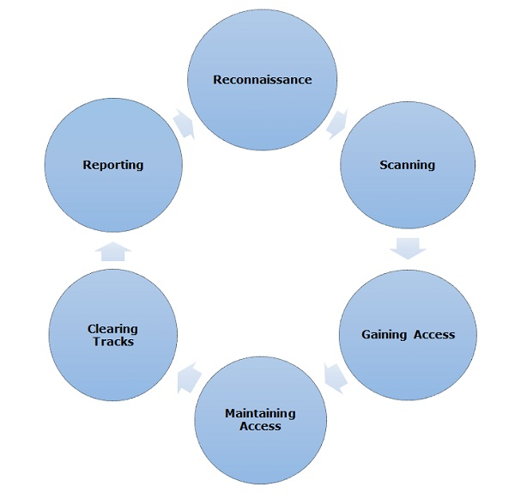
Hacking Phases
Reconnaissance
Scanning
Gaining Access
Maintaining Access
Clearing Tracks
Reporting

Slide 3
Scanning
During scanning, the hacker continues to gather information regarding the network and its individual host systems. Information such as IP addresses, operating system, services, and installed applications can help the hacker determine which type of exploit to use in hacking a system.

Slide 4

TCP vs. UDP
The devices and comptuers connected to the Internet use a protocol called TCP/IP to communicate with each other. When a computer in New York wants to send a piece of data to a computer in England, it must know the destination IP address that it would like to send the information to. That information is sent most often via two methods, UDP and TCP
TCP: Using this method, the computer sending the data connects directly to the computer it is sending the data to, and stays connected for the duration of the transfer. With this method, the two computers can guarantee that the data has arrived safely and correctly, and then they disconnect the connection.
UDP: UDP does not connect directly to the receiving computer like TCP does, but rather sends the data out and relies on the devices in between the sending computer and the receiving computer to get the data where it is supposed to go properly. This method of transmission does not provide any guarantee that the data you send will ever reach its destination.

Slide 5

TCP vs. UDP
TCP is slower than UDP because it has a lot more to do. TCP has to establish a connection, error-check, and guarantee that files are received in the order they were sent.
TCP is best suited to be used for applications that require high reliability where timing (delay) is less of a concern.
World Wide Web (HTTP, HTTPS)
Secure Shell (SSH)
File Transfer Protocol (FTP)
Email (SMTP, IMAP/POP)
UDP is best suited for applications that require speed and efficiency.
VPN tunneling
Live broadcasts (no delay is acceptable)
Streaming videos
Online games
Voice over IP

Slide 6
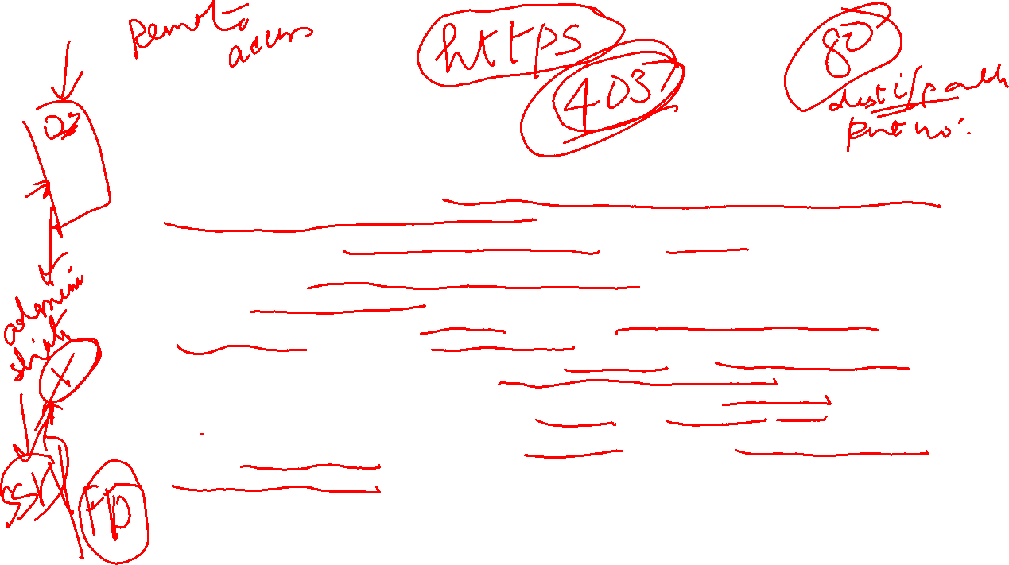
TCP and UDP ports
Every computer or device on the Internet must have a unique number assigned to it called the IP address. This IP address is used to recognize one particular computer out of the millions of other computers connected to the Internet. When information is sent over the Internet to your computer, it accepts that information by using TCP or UDP ports.
An easy way to understand ports is to imagine your IP address is a cable box and the ports are the different channels on that cable box. The cable company knows how to send cable to your cable box based upon a unique serial number associated with that box (IP Address), and then you receive the individual shows on different channels (Ports).
Ports work the same way. You have an IP address, and then many ports on that IP address. You can have a total of 65,535 TCP Ports and another 65,535 UDP ports. When a program on your computer sends or receives data over the Internet it sends that data to an ip address and a specific port on the remote computer, and receives the data on a usually random port on its own computer. If it uses the TCP protocol to send and receive the data then it will connect and bind itself to a TCP port. If it uses the UDP protocol to send and receive data, it will use a UDP port. E.g., 192.168.1.1:2869
Specific port numbers are reserved to identify specific services so that an arriving packet can be easily forwarded to a running application.
The operating system's networking software has the task of transmitting outgoing data from all application ports onto the network, and forwarding arriving network packets to processes by matching the packet's IP address and port number.

Slide 7

TCP and UDP ports
In order for a web server to accept connections from remote computers, such as yourself, it must bind the web server application to a local port. It will then use this port to listen for and accept connections from remote computers. Web servers typically bind to the TCP port 80, which is what the http protocol uses by default, and then will wait and listen for connections from remote devices. Once a device is connected, it will send the requested web pages to the remote device, and when done disconnect the connection.
On the other hand, if you are the remote user connecting to a web server it would work in reverse. Your web browser would pick a random TCP port from a certain range of port numbers, and attempt to connect to port 80 on the IP address of the web server. When the connection is established, the web browser will send the request for a particular web page and receive it from the web server. Then both computers will disconnect the connection.
Port addresses are decided during the handshake protocol of http.
Notes:
Port addresses decided during the handshake protocol of http

Slide 8

Ports

Slide 9

Types of Scanning

Slide 10

Port Scanning
Port scanning is the process of identifying open and available TCP/IP ports on a system. Port-scanning tools enable a hacker to learn about the services available on a given system. For example, The port 21 is associated with the FTP (File Transfer Protocol) service and the vulnerability can be Blade Runner which is a backdoor Trojan that affects Microsoft Windows operating systems. The backdoor uses a client/server relationship, where the server component is installed in the victim's system and the remote attacker has control of the client (someother local machine at his own end). The server attempts to open a port, typically TCP port 21, 5400, 5401 or 5402 to allow the client system to connect. Blade Runner could then allow a remote attacker to gain unauthorized access and gain complete control of the system.
Solution Recommended:
Use an up-to-date antivirus program to determine if the target computer is host to a backdoor program. If the program detects a backdoor, follow its instructions to disinfect and repair the computer.
Network Scanning Network scanning is a procedure for identifying active hosts on a network, either to attack them or as a network security assessment. Hosts are identified by their individual IP addresses. Network-scanning tools attempt to identify all the live or responding hosts on the network and their corresponding IP addresses.
Vulnerability Scanning Vulnerability scanning is the process of proactively identifying the vulnerabilities of computer systems on a network. Generally, a vulnerability scanner first identifies the operating system and version number, including service packs that may be installed. Then, the scanner identifies weaknesses or vulnerabilities in the operating system. During the later attack phase, a hacker can exploit those weaknesses in order to gain access to the system.

Slide 11

Ping Sweep

Slide 12
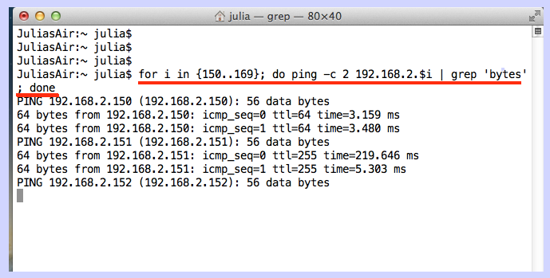
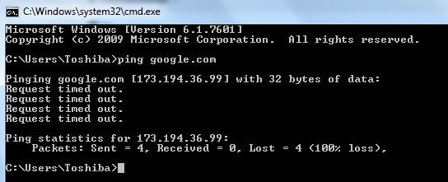


Ping Sweep

Slide 13
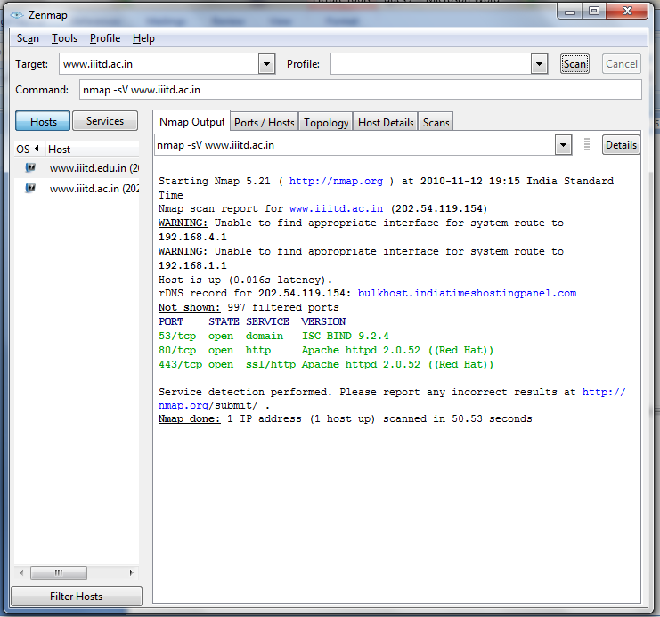

Nmap for Port Scanning
MOHONA GHOSH
Zenmap is the official cross-platform GUI for the Nmap Security Scanner. It is free and runs on Linux, Windows and Mac OS X.

Slide 14
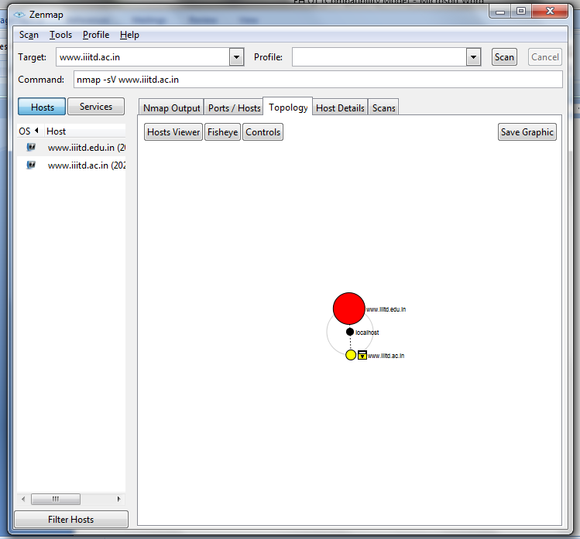

MOHONA GHOSH
Screenshot of the topology

Slide 15
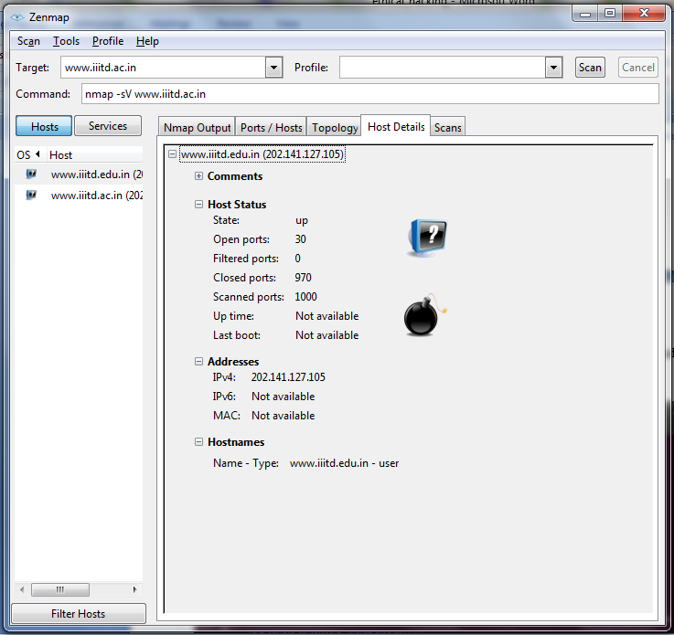
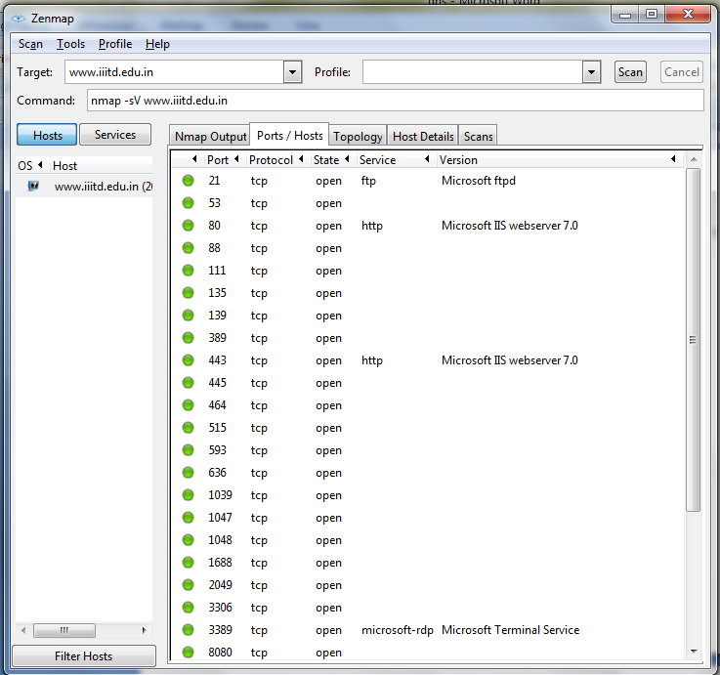

MOHONA GHOSH
MOHONA GHOSH

Slide 16

Tracerouting
E.g., Traceroute tool is used to trace the path between the sender and the destination host.

Slide 17

Prevention

Slide 18

Prevention

Slide 19


Hacking Phases
Reconnaissance
Scanning
Gaining Access
Maintaining Access
Clearing Tracks
Reporting

Slide 20

Gaining Access

Slide 21
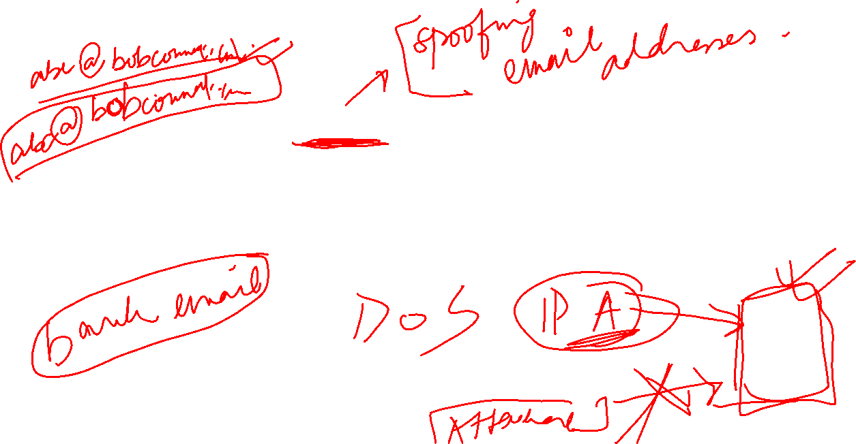
Gaining Access

Slide 22


Maintaining Access

Slide 23


Maintaining Access (Example)
MOHONA GHOSH

Slide 24

Clearing Tracks

